Slide 1
Achieve Profit and Equity using Deep Learning Marcus Deckert, ACAS; CARFAX Peggy Brinkmann, FCAS, MAAA; Milliman
2024 CAS RPM

Slide 2
Antitrust Notice
The Casualty Actuarial Society is committed to adhering strictly to the letter and spirit of the antitrust laws. Seminars conducted under the auspices of the CAS are designed solely to provide a forum for the expression of various points of view on topics described in the programs or agendas for such meetings.
Under no circumstances shall CAS seminars be used as a means for competing companies or firms to reach any understanding – expressed or implied – that restricts competition or in any way impairs the ability of members to exercise independent business judgment regarding matters affecting competition.
It is the responsibility of all seminar participants to be aware of antitrust regulations, to prevent any written or verbal discussions that appear to violate these laws, and to adhere in every respect to the CAS antitrust compliance policy.

Slide 3
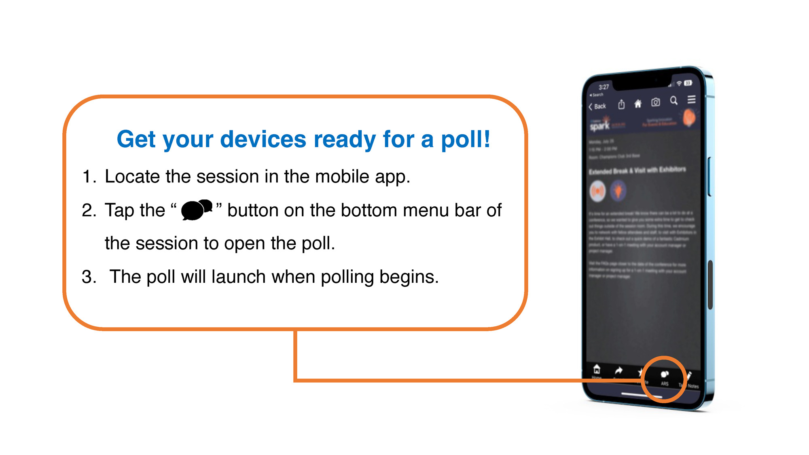

Slide 4
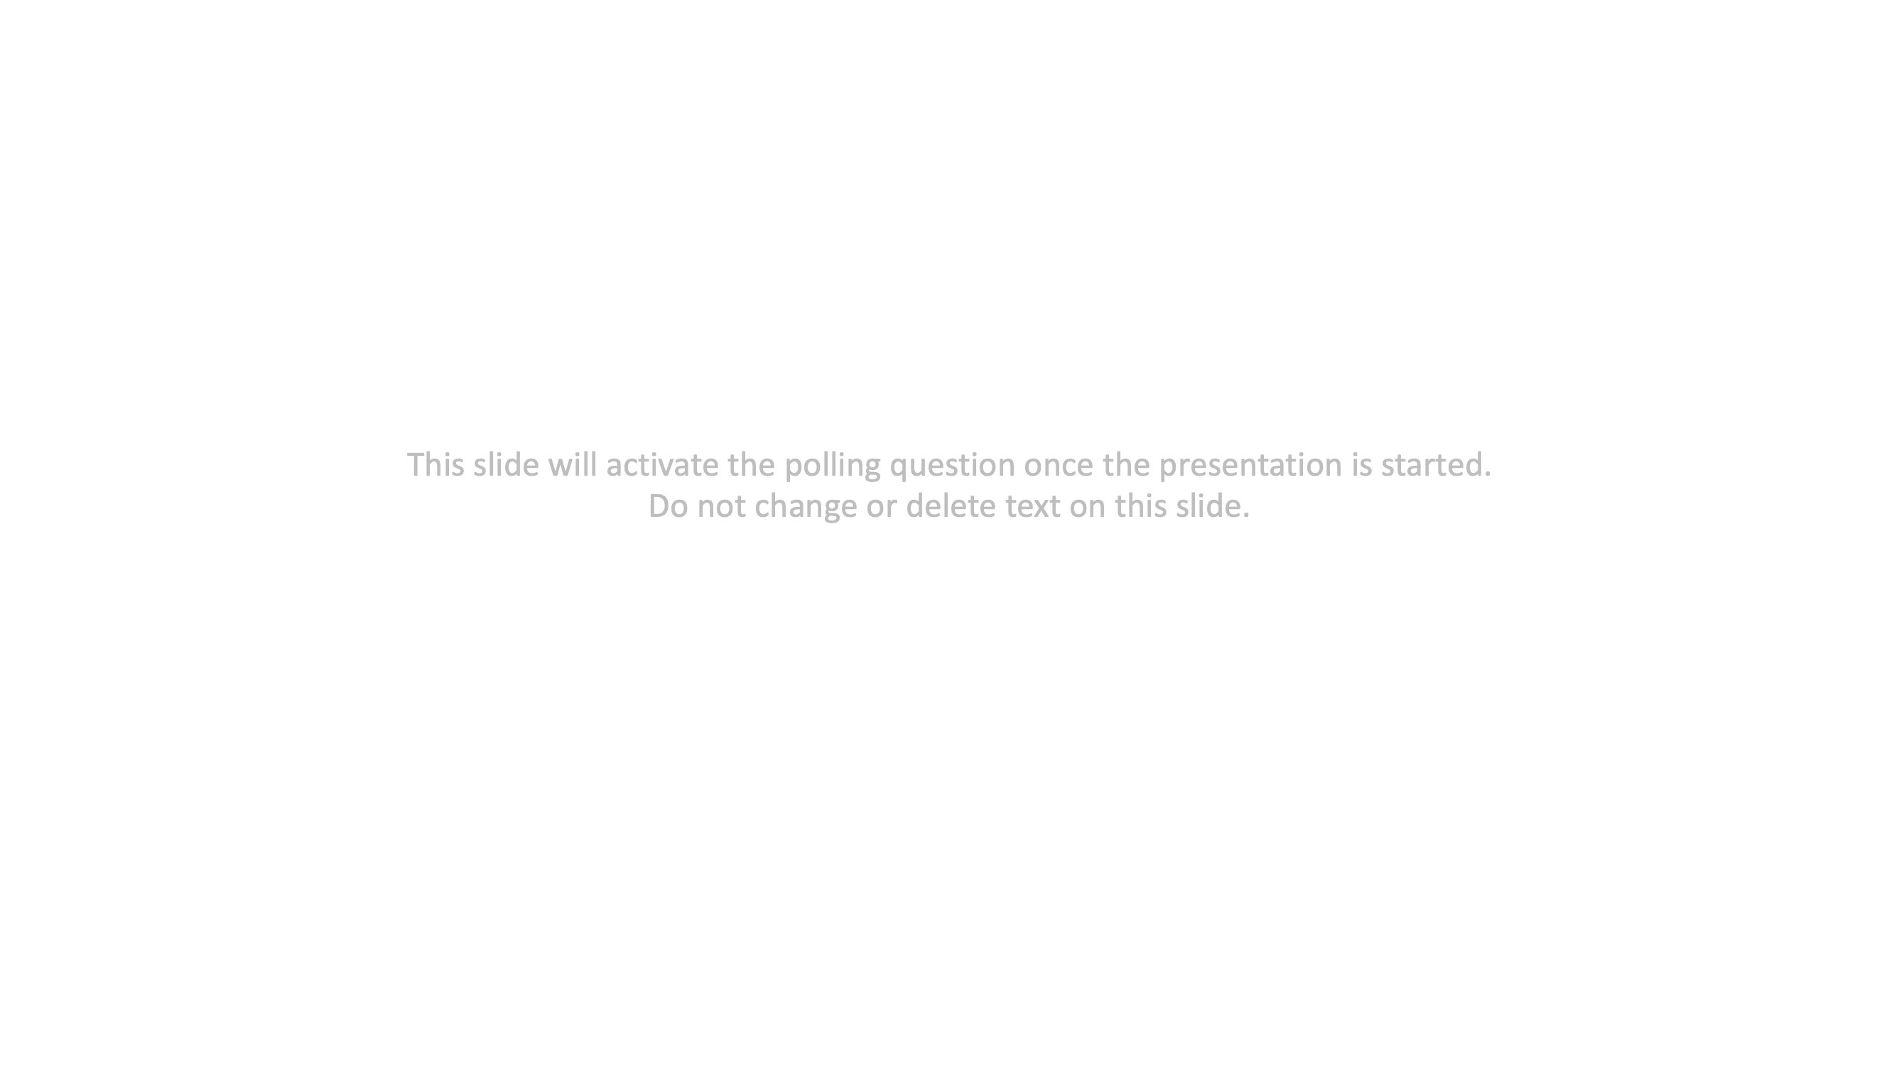
Poll Key= DBTSJ
Label = disagreement

Slide 5
Poll Key= FLKJS
Label = winner

Slide 6
Poll Key= LUNUJ
Label = equity measure

Slide 7
Poll Key= DKMCI
Label = equity action

Slide 8
Poll Key= WTDXI
Label = RL

Slide 9
Purpose/Intro
Reinforcement Learning (RL) is a powerful technique for making decisions based on trial and error within an environment with rewards and penalties guiding the learning process. This presentation shows an example using RL in a toy environment with rewards based on increasing equity with a constraint of increasing pricing accuracy. Specifically, the agent decides proposed pricing factors based on the reward function.
Alterations to this setup are boundless and likely to improve performance based on the specific task at hand.
The philosophy of this presentation is to empower you to help drive more accurate decision making in your organization using this framework. We do not necessarily believe this exact algorithm and architecture will yield the best results for your specific use case. Consider this a broader research topic to inspire you to do more work on your own. RL is a broadly applicable method that may be preferable anytime a closed form solution is not easily achievable.

Slide 10

Example of RL

Slide 11
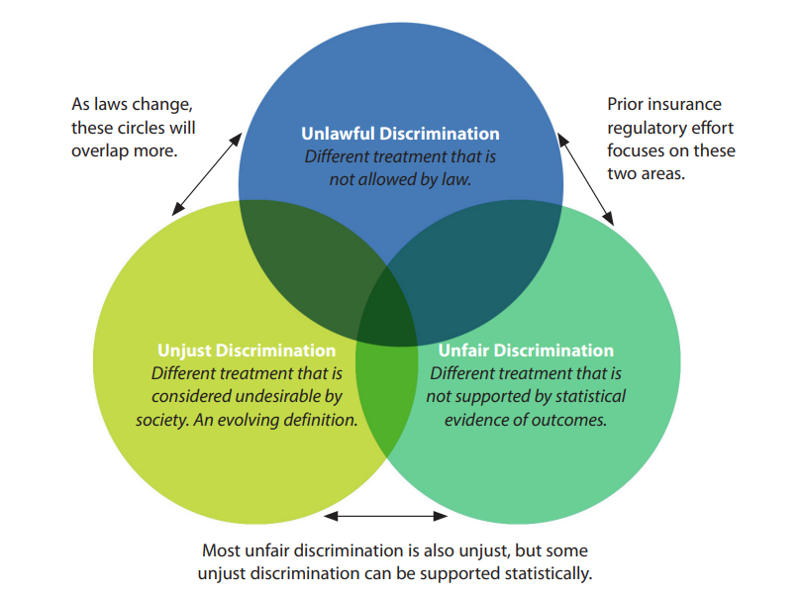
Defining Bias/Fairness
Proxy discrimination (NCOIL)
intentional substitution of a neutral factor for a factor based on a protected class
Disproportionate impact
higher or lower rates for a protected class, controlling for other distributional differences
Disparate impact
three-part legal definition
Source: American Academy of Actuaries, February 2024 Issue Brief
Notes:
Other proxy discrimination definitions (Defining Discrimination in Insurance, CAS):
FTC – whether variable acts as a statistical proxy
NAIC – ?
CEJ – disproportionate outcomes based on prohibited class membership
APCIA - ?

Slide 12
Sources of bias
Data
Modeling
Sampling - data is not representative of the population for which the model will be used
Correlation – data reflects correlations with protected classes, for example different distributions of
Driving record
Homeownership
Age
Address
Confirmation bias – choosing data/model that is consistent with prior expectations
Availability bias – placing more reliance on data that is more readily or recently available
Source: American Academy of Actuaries, July 2023 Issue Brief, “An Actuarial View of Data Bias: Definitions, Impacts, and Considerations”

Slide 13
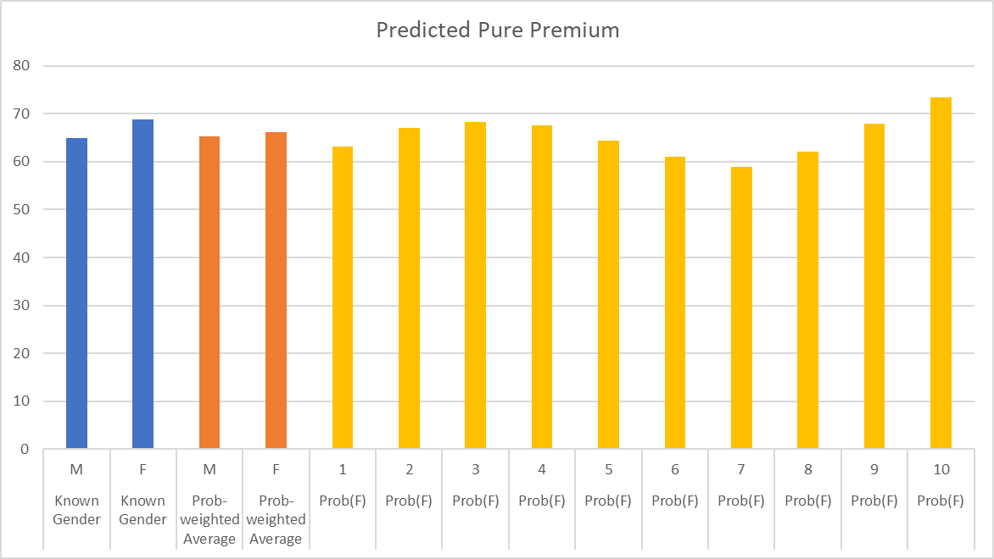
Bias metrics – demographic parity
Equal average premium by class
Also known as statistical parity or independence
Conditional demographic parity
Average premium is the same after controlling on “legitimate” or “traditional” factors (see draft CO reg 3 CCR 702-10)
Notes:
Model decision (or rate) with “traditional” predictors + protected class dummy variable
Is dummy statistically significant at 5%
Are differences more than 5%
Next test examines coefficients of models with and without dummy variable
A version of disproportionate impact?
Conditional demographic parity – require parity after conditioning on some “legitimate” subset of factors

Slide 14
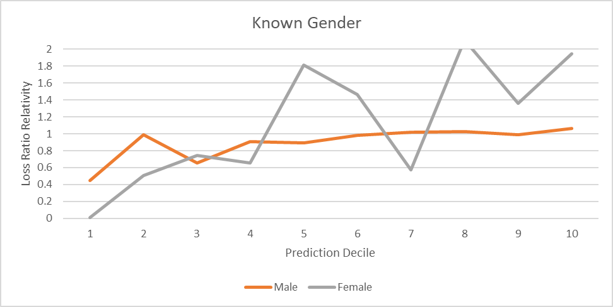
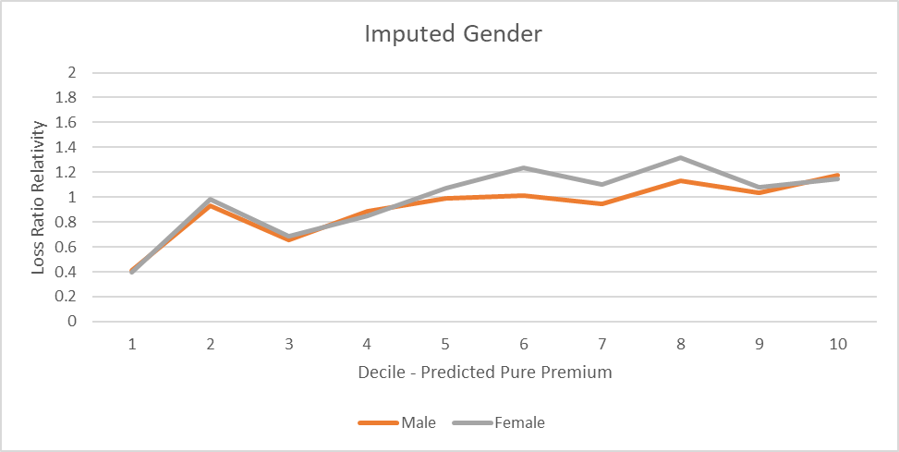
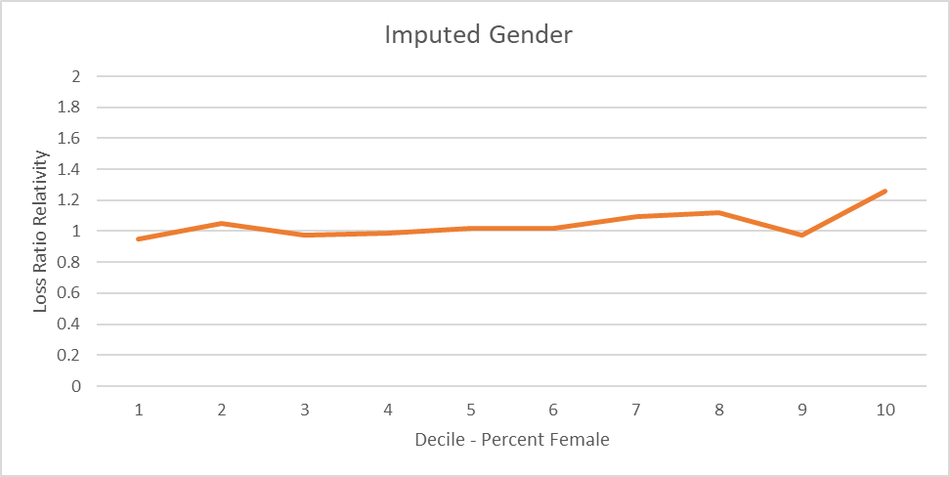
Bias metrics – predictive parity
Equal loss ratios by class
Also known as sufficiency, loss ratio tests, or calibration tests

Slide 15
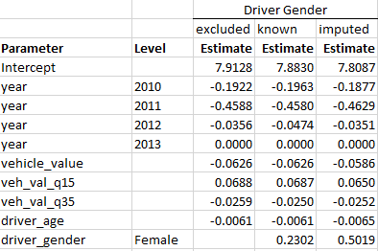
Bias metrics – proxy tests
Principal component analysis to show which variables are similarly impacting results
Include protected class in model and check for coefficient changes
Nonparametric matching
Notes:
Nonparametric matching:
Match insureds that are in different protected classes but have similar risk characteristics except for an evaluation variable.
Build model on the matched dataset with the evaluation variable included, and another model is built without the evaluation variable. Compare the average predictions from the two models for each protected class.
If the average prediction from the two models is significantly different for the same protected class, then the evaluation variable is determined to have a disproportionate impact on that protected class.
Like control variable approach, but breaks the correlations between rating variables and protected class

Slide 16
Bias mitigation methods - examples
Pre-model
Drop/prohibit certain rating variables
Re-weight or re-sample data
In-model
Add constraints to optimization objective
Post-model
Limit factor spread
Use Pope-Sydnor predictor
Transform predictors (e.g. orthogonalization, optimal transport)
Adversarial debiasing

Slide 17
Selecting a bias metric/mitigation approach
In their paper “Algorithmic Fairness: Contemporary Ideas in the Insurance Context,” Dolman and Semenovich state it would be prudent to act in four related ways:
Create Internal Clarity
be clear on why we consider our actions to be fair and reasonable
Acknowledge Imperfections
acknowledge the inherent tradeoffs required
Be Adaptable
adapt any answer over time, particularly as the research environment matures
Act With Humility
commit to openly discuss views which may contradict our own, to rectify any issues as they are identified, and to adapt according to society’s evolving norms

Slide 18
Technical Stuff
Technical work done for this presentation used the following:
Python language in Jupyter Notebook
Python package stable_baselines3
Proximal Policy Optimization (PPO) algorithm
CPU on a laptop; there is opportunity to use GPU and increase performance
RL terminology you need (imagine Albert in the video):
Environment: the rooms he was placed into and the obstacles presented
Action Space: the available choices to make (movement of his limbs and torso)
Reward: when he hit the green squares, he was given a positive reward
Penalty: adjustments to the reward to disincentivize undesired actions
Agent: Albert is the agent
Timestep: each action occurs sequentially, once per timestep

Slide 19
Process Overview
For our process, we have the following components:
Environment
In-Force book of policy characteristics & premium
Current and indicated pricing factors from pricing work (Credit, Age)
Inequity metric based on avg premium by % Black (derived from zip code data)
Action Space
Selected pricing factors must be between current and indicated
Reward Function
Reward function for each step is the incremental improvement in equity metric
Penalty
If the pricing factor selected results in a worsening of the pricing accuracy, the reward is set to a large negative value.
For simplicity, our process assumes a single point in time. Accounting for future policy period expectations is trivial to add.
Unlike Albert, our agent doesn’t need to generalize to other environments. We only need it to optimize the current environment. This makes our job much easier!

Slide 20
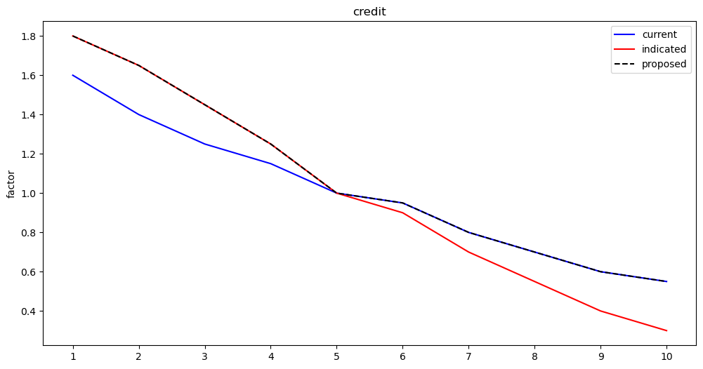
Baby Steps – Target UW Profit (different use case)
Using target of UW profit for a single pricing factor, the agent does what UW and Sales think all actuaries do.
We have probably all heard “A dollar of rate is better than a dollar of retention”.
This naïve first step helps us to see that the agent learns in a very clear situation.

Slide 21
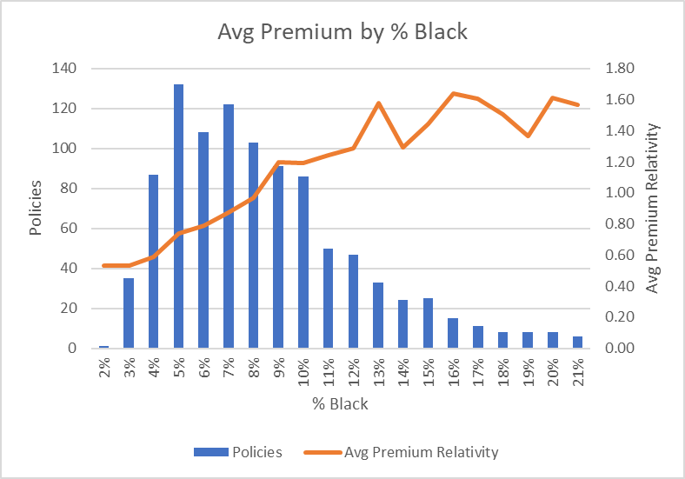


























Inequity Metric
We used % black which can be obtained from the U.S. Census Bureau by zip code
Our inequity metric is the weighted average of the premium relativity difference from unity by % black, based on our own book.
The absolute value of the highlighted yellow area represents the metric. We seek to minimize this.
Our definition does not intend to imply what is “fair” or “equitable”. It is one of many possible metrics to use. Determination of what is “fair” or “equitable” is beyond the scope of our work here.

Slide 22
Step 1 – Target Equity Setup & Expectation
Instead using equity as our target, we expect a different result due to the distribution of our % Black by Credit.
We expect the agent to propose reductions to credit level 1-4 while leaving levels 6-10 unchanged.
% Black by credit guided by FTC study, cited on citations slide

Slide 23
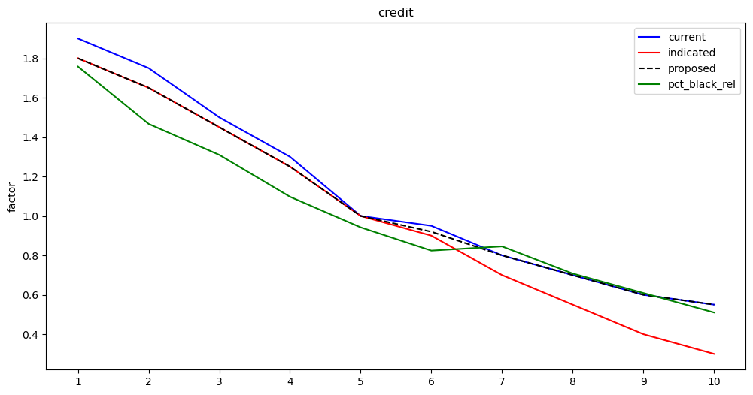
Step 1 – Credit Factor; Success

Slide 24
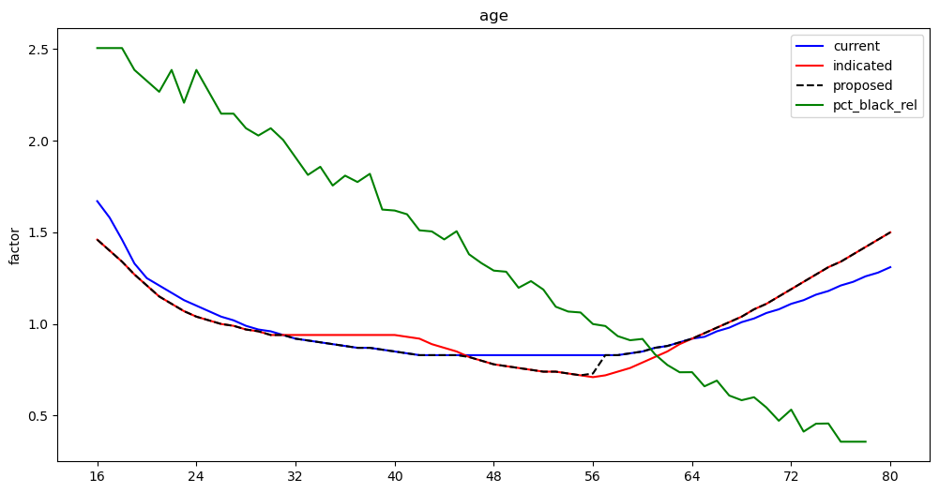
Step 2 – Age Factor

Slide 25
Process Flow
This toy example is pretty simple. There are pricing factors for credit based insurance score decile and policyholder age. The agent optimizes one pricing factor at a time. We can run multiple iterations so that interactions between the pricing factor curves can be worked out iteratively.
1 iteration was run here – the diagram serves as theory for more complicated use cases.
Rate Table 1
Rate Table 2
…
Rate Table n
Iteration 1
…
…
…
…
…
Rate Table 1
Rate Table 2
…
Rate Table n
Iteration n

Slide 26
Process Notes & Results
The reward function is an all-purpose metric which can account for “everything”. Whatever you want to include, it essentially comes down to the agent evaluating the results of a dislocation given the actions it chooses at each timestep.
Penalties are applied within the reward function based on whatever actions need to be avoided for the task at hand.
The following slides show the results of the process.

Slide 27
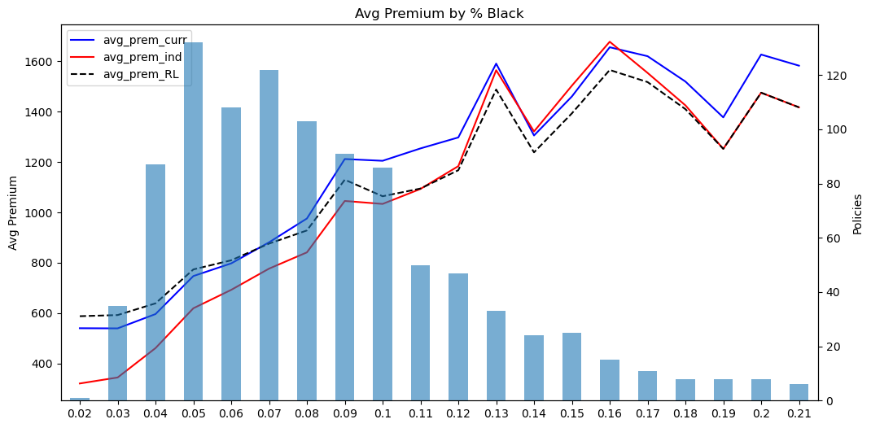
Avg Premium by % Black

Slide 28
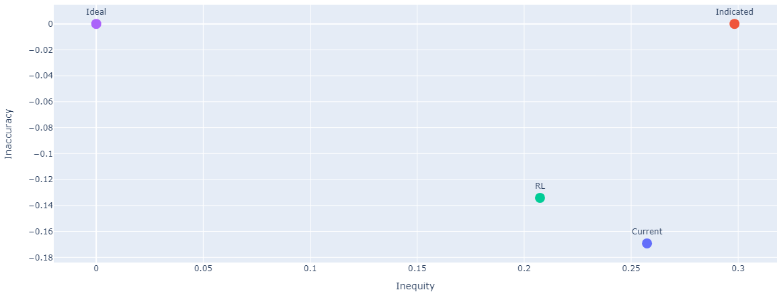
Inequity vs Inaccuracy

Slide 29
Conclusions
The process shown here can be used to help guide business decisions around pricing factors to move toward equitable outcomes. Choice of equity/fairness metric(s) is open to expansion.
There are many other frameworks for bias mitigation. This is another option for you to consider.
This is a general framework that may be applied to other purposes as you see fit. RL is a powerful tool with many existing and future applications.
Code and toy data is available here: https://github.com/RuthlessActuary2023

Slide 30
Questions?

Slide 31
Citations
% Black by credit was guided by the following study:
https://www.ftc.gov/sites/default/files/documents/reports/credit-based-insurance-scores-impacts-consumers-automobile-insurance-report-congress-federal-trade/p044804facta_report_credit-based_insurance_scores.pdf?WT.qs_osrc=fxb-184546610
American Academy of Actuaries, “Discrimination: Considerations for Machine Learning, AI Models, and Underlying Data”.
https://www.actuary.org/sites/default/files/2023-08/risk-brief-discrimination.pdf
American Academy of Actuaries, “An Actuarial View of Data Bias: Definitions, Impacts, and Considerations”.
https://www.actuary.org/sites/default/files/2023-07/risk_brief_data_bias.pdf
American Academy of Actuaries, “Approaches to Identify and/or Mitigation Bias in Property and Casualty Insurance”.
https://www.actuary.org/sites/default/files/2023-02/CPCdataBiasIB.2.23_0.pdf
Dolman and Semenvich, “Algorithmic Fairness: Contemporary Ideas in the Insurance Context”.
https://www.actuaries.org.uk/system/files/field/document/B9_Chris%20Dolman.pdf

